Slide 1

How to make an app for Zendesk

Slide 2
Origin of my new app

Slide 3
<style>
input.createtable {
display:none;
}
</style>
<script language="JavaScript">
<!--
writeConsole = function(content) {
top.consoleRef=window.open('','myconsole',
'width=637,height=825'
+',menubar=1'
+',toolbar=1'
+',status=0'
+',scrollbars=1'
+',resizable=1')
top.consoleRef.document.open("text/html","replace");
top.consoleRef.document.writeln(
'<html><head><title>Signature Page</title>'
+'</head>'
+'<style>'
+'th {'
+'color: #FFFFFF;'
+'border-bottom: 1px solid #000000;'
+'border-top: 1px solid #000000;'
+'background-color:#CCCCCC;'
+'}'
+'ul li{'
+'list-style-type:decimal;'
+'}'
+'table { empty-cells: show; }'
+'td#solution{'
+'border-left:3px solid #000000;'
+'border-bottom:3px solid #000000;'
+'border-top:3px solid #000000;'
+'width:2000px;'
+'}'
+'<table width="100%"><tr><td width=50%>'
+'<img src="http://www.tcicollege.edu/sites/default/files/tci_favicon.png">College Of Technology</center>'
+'</td><td width=50% align=left>'
+'http://www.tcicollege.edu<br />'
+'http://helpdesk.tcicollege.edu<br />'
+'212-594-4000<br />'
+'</td></tr></table>'
+content
</tr>
<tr>
<td><strong>Ticket ID#:</strong> {{ticket.id}}<br /><strong>Ticket URL:</strong> {{ticket.url}}<br /></td>
<td><strong>Serial Number \ Service Tag#:</strong>{{ticket.ticket_field_21139718}}<br /></td>
</tr>
<tr>
<th colspan=2><strong>INITIAL ISSUE</strong></th>
</tr>
<tr>
<td width=100%>{{ticket.ticket_field_102110}}</td><br/>
</tr>
<tr>
<th colspan=4><strong>SOLUTION TAKEN</strong></th>
</tr>
<tr>
<td height='120px' id='solution'></td>
<td height='120px' id='solution1'></td>
</tr>
<tr>
<th colspan=2><strong>SIGNATURE INDICATES AGREEMENT</strong></th>
</tr>
<tr>
<td><br /><br /><iframe src='http://www.dreamcpu.com/signature.html' height='90px' width='275px' frameborder='0'>
<p>Your browser does not support iframes.</p>
</iframe><br />{{ticket.requester.name}}</td>
<td><br /><br /><hr>Date</td></tr>
<tr>
<td><br /><br /><hr>Technician:{{current_user.name}}</td>
<td><br /><br /><hr>Date</td>
</tr>
</table>">
<input type=button value="Ticket Signing Sheet"
onClick="writeConsole(this.form.userInput.value)"
>
</form>
+'</body></html>'
)
top.consoleRef.document.close()
}
//-->
</script>
<form>
<input class="createtable" name=userInput " value="<table width=100% cellpadding=7>
<tr>
<th colspan=2>CUSTOMER INFORMATION</th>
</tr>
<tr>
<td width=50%><strong>Name</strong>: {{ticket.requester.name}}<br />
<strong>Organization</strong>: {{ticket.organization.name}}</td>
<td width=50% align=left><strong>Phone</strong>: {{ticket.ticket_field_116678}}<br />
<strong>Email</strong>: {{ticket.requester.email}}<br />
<strong>Student ID</strong>: {{ticket.ticket_field_21306086}}</td>
</tr>
<tr>
<th colspan=2><strong>COMPUTER INFORMATION:</strong></th>
+'td#solution1{'
+'border-right:3px solid #000000;'
+'border-bottom:3px solid #000000;'
+'border-top:3px solid #000000;'
+'width:2000px;'
+'}'
+'</style>'
+'<body onLoad="self.focus()" style="background: white; font-size: 11px; font-family: Arial, Helvetica, sans-serif">'
+'<center><A HREF="javascript:window.print()">Click to Print This Page</A></center>'

Slide 4
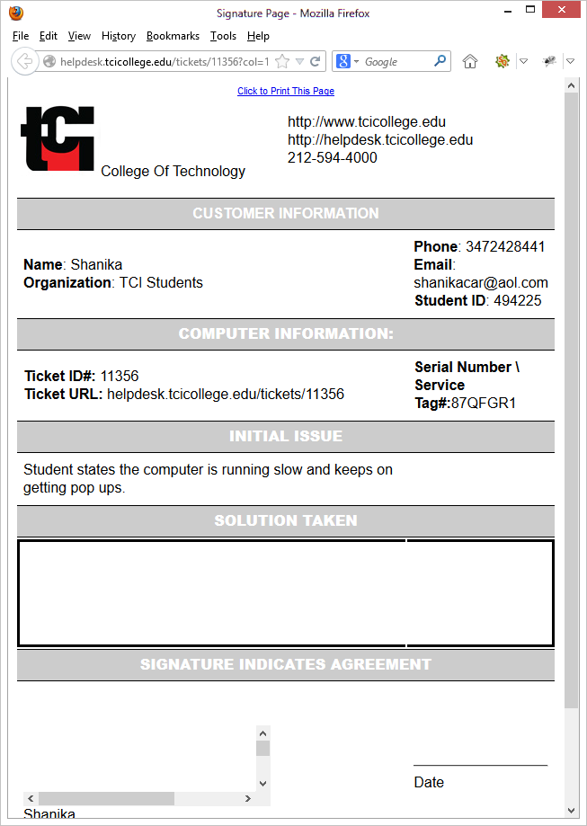

Slide 5
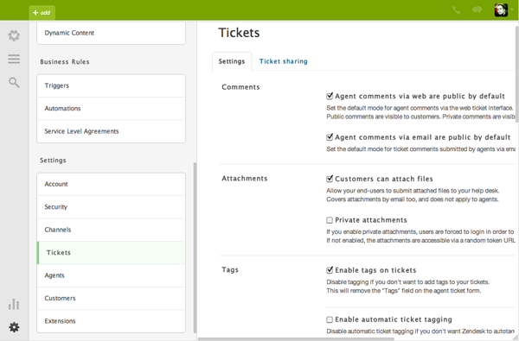

Slide 6
<style>
input.createtable {
display:none;
}
</style>
<script language="JavaScript">
<!--
writeConsole = function(content) {
top.consoleRef=window.open('','myconsole',
'width=637,height=825'
+',menubar=1'
+',toolbar=1'
+',status=0'
+',scrollbars=1'
+',resizable=1')
top.consoleRef.document.open("text/html","replace");
top.consoleRef.document.writeln(
'<html><head><title>Signature Page</title>'
+'</head>'
+'<style>'
+'th {'
+'color: #FFFFFF;'
+'border-bottom: 1px solid #000000;'
+'border-top: 1px solid #000000;'
+'background-color:#CCCCCC;'
+'}'
+'ul li{'
+'list-style-type:decimal;'
+'}'
+'table { empty-cells: show; }'
+'td#solution{'
+'border-left:3px solid #000000;'
+'border-bottom:3px solid #000000;'
+'border-top:3px solid #000000;'
+'width:2000px;'
+'}'
+'<table width="100%"><tr><td width=50%>'
+'<img src="http://www.tcicollege.edu/sites/default/files/tci_favicon.png">College Of Technology</center>'
+'</td><td width=50% align=left>'
+'http://www.tcicollege.edu<br />'
+'http://helpdesk.tcicollege.edu<br />'
+'212-594-4000<br />'
+'</td></tr></table>'
+content
</tr>
<tr>
<td><strong>Ticket ID#:</strong> {{ticket.id}}<br /><strong>Ticket URL:</strong> {{ticket.url}}<br /></td>
<td><strong>Serial Number \ Service Tag#:</strong>{{ticket.ticket_field_21139718}}<br /></td>
</tr>
<tr>
<th colspan=2><strong>INITIAL ISSUE</strong></th>
</tr>
<tr>
<td width=100%>{{ticket.ticket_field_102110}}</td><br/>
</tr>
<tr>
<th colspan=4><strong>SOLUTION TAKEN</strong></th>
</tr>
<tr>
<td height='120px' id='solution'></td>
<td height='120px' id='solution1'></td>
</tr>
<tr>
<th colspan=2><strong>SIGNATURE INDICATES AGREEMENT</strong></th>
</tr>
<tr>
<td><br /><br /><iframe src='http://www.dreamcpu.com/signature.html' height='90px' width='275px' frameborder='0'>
<p>Your browser does not support iframes.</p>
</iframe><br />{{ticket.requester.name}}</td>
<td><br /><br /><hr>Date</td></tr>
<tr>
<td><br /><br /><hr>Technician:{{current_user.name}}</td>
<td><br /><br /><hr>Date</td>
</tr>
</table>">
<input type=button value="Ticket Signing Sheet"
onClick="writeConsole(this.form.userInput.value)"
>
</form>
+'</body></html>'
)
top.consoleRef.document.close()
}
//-->
</script>
<form>
<input class="createtable" name=userInput " value="<table width=100% cellpadding=7>
<tr>
<th colspan=2>CUSTOMER INFORMATION</th>
</tr>
<tr>
<td width=50%><strong>Name</strong>: {{ticket.requester.name}}<br />
<strong>Organization</strong>: {{ticket.organization.name}}</td>
<td width=50% align=left><strong>Phone</strong>: {{ticket.ticket_field_116678}}<br />
<strong>Email</strong>: {{ticket.requester.email}}<br />
<strong>Student ID</strong>: {{ticket.ticket_field_21306086}}</td>
</tr>
<tr>
<th colspan=2><strong>COMPUTER INFORMATION:</strong></th>
+'td#solution1{'
+'border-right:3px solid #000000;'
+'border-bottom:3px solid #000000;'
+'border-top:3px solid #000000;'
+'width:2000px;'
+'}'
+'</style>'
+'<body onLoad="self.focus()" style="background: white; font-size: 11px; font-family: Arial, Helvetica, sans-serif">'
+'<center><A HREF="javascript:window.print()">Click to Print This Page</A></center>'

Slide 8

NOTHING

Slide 9

How do I convert my widget to an app???

Slide 10

http://developer.zendesk.com/documentation/apps/migration/introduction.html
http://developer.zendesk.com/documentation/apps/

Slide 11
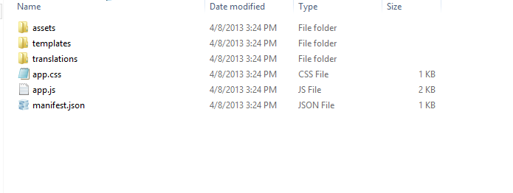

Slide 12
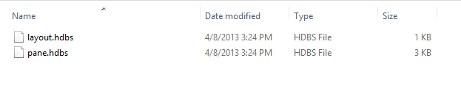
Inside of templates folder

Slide 13
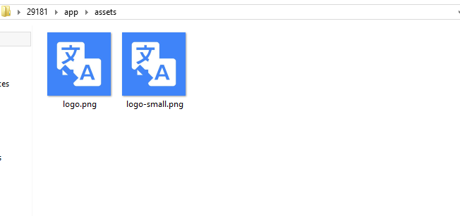
Inside the assets folder

Slide 14
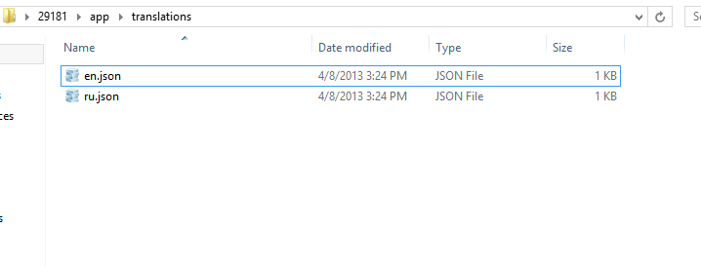
Inside the translations folder

Slide 15
APP.CSS
input.createtable {
display:none;
}
th {
color: #FFFFFF;
border-bottom: 1px solid #000000;
border-top: 1px solid #000000;
background-color:#CCCCCC;
}
ul li{
list-style-type:decimal;
}
table { empty-cells: show; }
td#solution{
border-left:3px solid #000000;
border-bottom:3px solid #000000;
border-top:3px solid #000000;
width:2000px;
}
td#solution1{
border-right:3px solid #000000;
border-bottom:3px solid #000000;
border-top:3px solid #000000;
width:2000px;
}

Slide 16
APP.JS
(function() {
return {
events: {
// When activated
'app.activated': function(data){
var ticket = this.ticket(); //get ticket
var ticket_id = this.ticket().id();
var ticket_url = "https://tcicollege.zendesk.com/request/"+ticket_id;
var service_tag = this.ticket().customField('custom_field_21139718');
var student_id = this.ticket().customField('custom_field_21306086');
var phone_number = this.ticket().customField('custom_field_116678');
var email = this.ticket().requester().email();
var name = this.ticket().requester().name();
var description = ticket.description();
var current_user = this.ticket().currentUser().name();
var object = {"ticket_id":ticket_id, "ticket_url":ticket_url, "cfield_1":service_tag, "student_id":student_id,"phone_number":phone_number,"r_email":email,"r_name":name,"description":description,"r_cuser":current_user};
// show interface
this.switchTo('pane', {
"ticket": object
}
);
}
}
};
}());

Slide 17


Slide 18
PANE.HDBS
<script language="JavaScript">
<!--
writeConsole = function(content) {
top.consoleRef=window.open('','myconsole',
'width=637,height=825'
+',menubar=1'
+',toolbar=1'
+',status=0'
+',scrollbars=1'
+',resizable=1')
top.consoleRef.document.open("text/html","replace");
top.consoleRef.document.writeln(
'<html><head><title>Signature Page</title>'
+'<link rel="stylesheet" type="text/css" media="screen" href="http://www.dreamcpu.com/style/app.css" />'
+'</head>'
+'<body onLoad="self.focus()" style="background: white; font-size: 11px; font-family: Arial, Helvetica, sans-serif">'
+'<center><A HREF="javascript:window.print()">Click to Print This Page</A></center>'
+'<table width="100%"><tr><td width=50%>'
+'<img src="http://www.tcicollege.edu/sites/default/files/tci_favicon.png">College Of Technology</center>'
+'</td><td width=50% align=left>'
+'http://www.tcicollege.edu<br />'
+'http://helpdesk.tcicollege.edu<br />'
+'212-594-4000<br />'
+'</td></tr></table>'
+content
+'</body></html>'
)
top.consoleRef.document.close()
}
//-->
</script>
<form>
<input class="createtable" name=userInput " value="<table width=100% cellpadding=7>
<tr>
<th colspan=2>CUSTOMER INFORMATION</th>
</tr>
<tr>
<td width=50%><strong>Name</strong>: {{ticket.r_name}}<br />
<strong>Organization</strong>: {{ticket.organization.name}}</td>
<td width=50% align=left><strong>Phone</strong>: {{ticket.phone_number}}<br />
<strong>Email</strong>: {{ticket.r_email}}<br />
<strong>Student ID</strong>: {{ticket.student_id}}</td>
</tr>
<tr>
<th colspan=2><strong>COMPUTER INFORMATION:</strong></th>
</tr>
<tr>
<td><strong>Ticket ID#:</strong> {{ticket.ticket_id}} <br /><strong>Ticket URL:</strong> {{ticket.ticket_url}}<br /></td>
<td><strong>Serial Number \ Service Tag#:</strong>{{ticket.cfield_1}}<br /></td>
</tr>
<tr>
<th colspan=2><strong>INITIAL ISSUE</strong></th>
</tr>
<tr>
<td width=100%>{{ticket.description}}</td><br/>
</tr>
<tr>
<th colspan=4><strong>SOLUTION TAKEN</strong></th>
</tr>
<tr>
<td height='120px' id='solution'></td>
<td height='120px' id='solution1'></td>
</tr>
<tr>
<th colspan=2><strong>SIGNATURE INDICATES AGREEMENT</strong></th>
</tr>
<tr>
<td><br /><br /><iframe src='http://www.dreamcpu.com/signature.html' height='90px' width='275px' frameborder='0'>
<p>Your browser does not support iframes.</p>
</iframe><br />{{ticket.requester.name}}</td>
<td><br /><br /><hr>Date</td></tr>
<tr>
<td><br /><br /><hr>Technician:{{ticket.r_cuser}}</td>
<td><br /><br /><hr>Date</td>
</tr>
</table>">
<input type=button value="Ticket Signing Sheet"
onClick="writeConsole(this.form.userInput.value)">
</form>

Slide 19
MANIFEST.JSON
{
"author": {
"name": "Jose Ortiz",
"email": "jortiz@tcicollege.edu"
},
"location": "ticket_sidebar",
"defaultLocale": "en",
"private": true,
"singleInstall": true,
"frameworkVersion": "0.5"
}

Slide 20
Github Repository
https://github.com/wayko/ZendeskApp.git

